Slide 1
Transformation Self- Assessment & Planning Thomas Wilds National Subject Matter Expert
Alabama Transformation Workshop
March 3, 2020

Slide 2
The Expectation
Integrated Community Engagement
&
Competitive Integrated Employment

Slide 3
The Planning Process
Convening a Change Management Team
The Agency Self-Assessment
Components of the Assessment & Plan
Developing the Transformation Plan

Slide 4
Convening A Change Management Team
No one person can make the change nor should they try
Team composition will have an impact om results.
Have broad representation of stakeholders with multiple perspectives
Set clear expectations for member participation & contribution.

Slide 5
Supporting Change Management Teams
Training in Team Problem Solving
Set regular meeting times and dates
Set agendas in advance
Take and distribute minutes, include assignments, expectations
Facilitate participation for members

Slide 6
Criteria for Performance Excellence in Provider Transformation
Leadership
Strategic Planning
Customer Focus
Workforce Focus
Operations Focus
Measurement, Analysis & Knowledge Management
Results

Slide 7
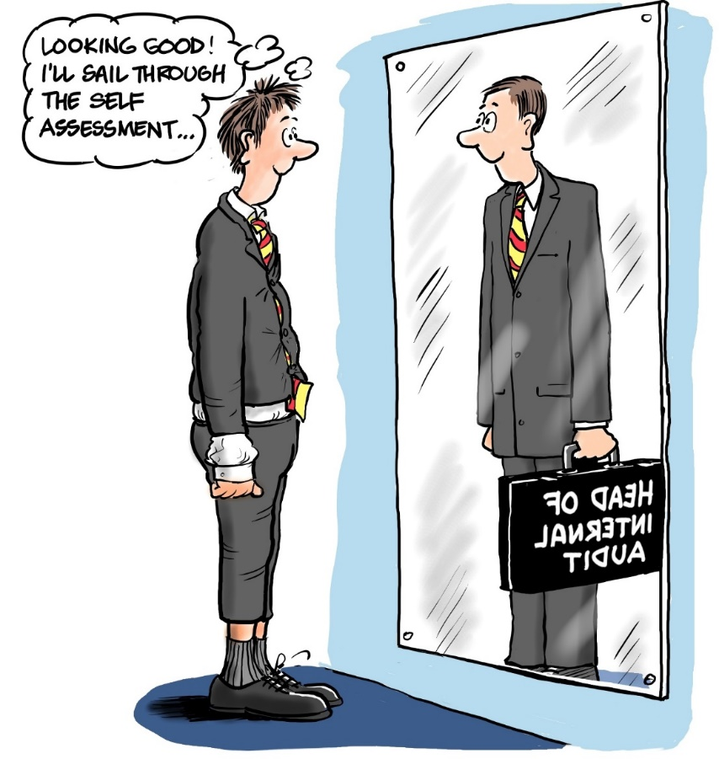
Agency Self-Analysis
Why self-analysis?
Who should be involved?
What do we do with the results?
How does this relate to the change process?

Slide 8
Understanding Who You Are
Take a deep and honest look at your agency and where you are today
Examine what you do
Look at how you do it
Ask why you do things that way
Understand where you are putting your resources and outcomes

Slide 9
Understand the Process of Change - What Will Be Impacted
Important to grasp not only where your agency is but where it is going & what is involved in the process of change
All aspects of the agency are impacted
Everyone has to be informed and on board
Communication is essential especially during change
Notes:
MRC in Michigan -

Slide 10
Leadership
Foundation:
Vision, values, mission
Team Development
Team Planning
Oversight

Slide 11
Leadership
Communication Planning: Create a culture of inclusion
Mission, Vision, Values
Success stories
Acknowledge contributions
Photos of active engagement
Education-benefits, legal, regulations
Thank you

Slide 12
Leadership
Advocacy: How & Who?
Best practices, legislation, regulations requirements
Your agency’s specific needs/ Talking points
Provider Associations Membership & Training
APSE & ANCOR Membership
Testifying for State & Local budgets & government oversight Committees
Relationships with government leaders & elected officials

Slide 13
Leadership
Strategic Planning:
When last developed?
Who was involved?
Did it include Community Integrated Engagement Services and Competitive Integrated Employment?

Slide 14
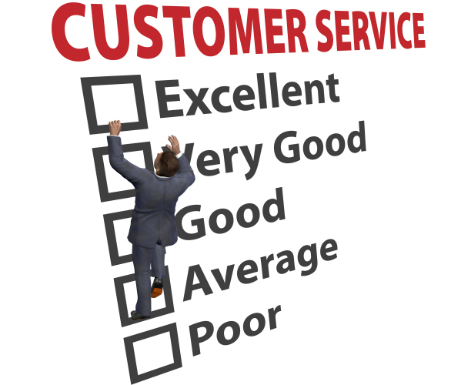
Customer Focus
Survey Needs
Person Centered Planning
Assessment in Community Settings
Defining “Educated” Choice
Benefits Planning
Community Manual

Slide 15
Workforce Focus
Staff Deployment
Qualities and Skills
Recruitment and Hiring
Staff Training
Staff Support

Slide 16
Operations Focus
People Served and Services
Funding and Relationships
Finance
Development

Slide 17
Operations Focus
Services:
Who are we serving and what are the services we are currently providing?
How many people are we serving in each area?
What are our funding sources and are we using them optimally?
How do we feel about our quality?

Slide 18
Operations Focus
Funding:
Who are our funders ?
Do we have plans to diversify our funding?
Are we participating in local and statewide efforts to get adequate funding for the services we are providing?

Slide 19
Operations Focus
Building Relationships:
What community relationships do we have?
Are our funders pleased with our performance?
How do we know?
Are we getting sufficient referrals from our funders?

Slide 20
Operations Focus
Finance:
What is our total annual budget?
What percentage does each of the services below represent in our budget?
Community integrated employment, individual placement
Community employment, group
Facility based work
Community based pre-vocational services
Facility based pre-vocational services
Community based day support services
Facility based day support services

Slide 21
FINANCE2
What percentage is staffing of our total budget?
What locations do we operate out of? Do we own or lease these facilities or offices?
What percent of our budget is devoted to staff development?

Slide 22
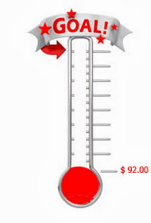
Operations Focus
Fundraising:
Do we raise private funds or grant dollars?
What percent of private funds are represented in our budget?
Do we have designated staff to do fundraising or grant development?

Slide 23
Measurement, Analysis and Knowledge Management
Quality Assurance
Customer Feedback

Slide 24
Quality Assurance
Are we accredited by an entity external to the state? What were the outcomes by the most recent survey?
What were the results of our most recent surveys of quality and compliance by our funding sources regarding community employment and meaningful community day support?
What were the overall strengths and opportunities for improvement in recent surveys?

Slide 25
Feedback
Do we routinely survey individuals served, their families, case managers, employers and other key stakeholders to assess their satisfaction with services provided?
Do we survey staff routinely to assess their satisfaction with the support and training provided to them?
Do we respond to the feedback that we get through the surveys and take action as needed?

Slide 26
Data
Benchmarking
Information Technology

Slide 27
Data and Benchmarking
Do we use data to benchmark our performance in achieving individual and agency outcomes towards community integrated employment?
Do we record data on competitive integrated employment including:
Length of time to placement
Type of placement achieved
Wages/hours of work
Method for placement
Career advancement or termination of employment
Do we use data for management purposes?

Slide 28
Information Technology
Do we have an electronic data based system for customer information and data collection?
Do we have strategies and devices for communication with staff in the community?
Do we compensate staff for use for personal devices if they are required to use them?

Slide 29
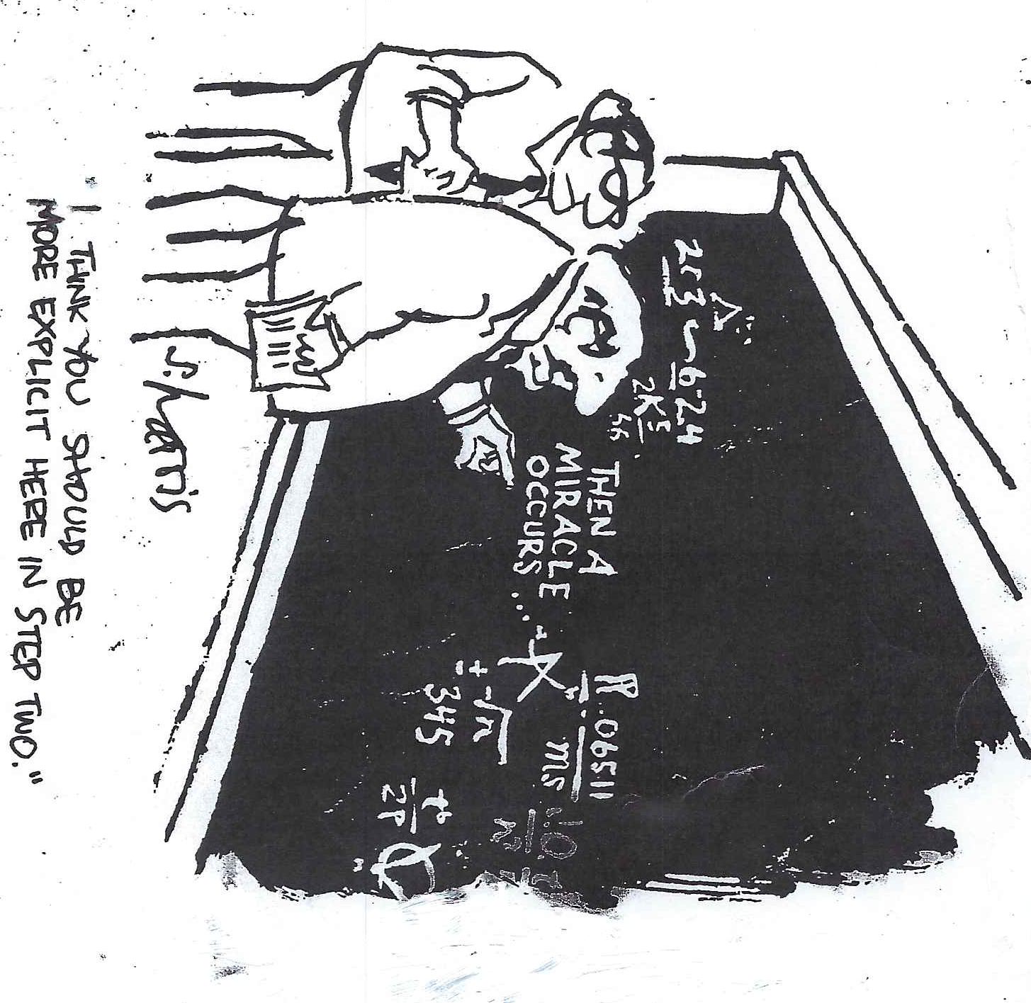
5. Measurement, Results, Analysis and Data Management

Slide 30
5. Data-based Decision Making
Project progress in all areas
Collect data
Manage knowledge
Add technology
Create Efficiencies
Document
Move Forward

Slide 31
Transformation Plan Development
Collect data in each area
Prioritize areas to be addressed
ID team members & establish meeting rules
Identify issues, planning steps & timelines
consider technology & create Efficiencies
Document meetings
Move Forward

Slide 32
Learship: Core Values
Activity | Responsible | Timeframe | Resources | Comments
1.) Develop the planning team | CEO/COO/CFO HR/Prog Managers | May 1 | Reg schedule senior meeting
2.)review mission, vision, core values | Management team | May 15 | Reg. Schedule team meeting
3.) Schedule focus groups to explore core values. Divide into groups | Prog Managers, staff, Participants, families, board members | June 15 | Consultants Small conf room
4.) Large group meeting, consolidate value statements | Invite previous participants | July 15 | Large conf room
intermediate – evaluate finance

Slide 33
Group Discussion 1
How will you prepare the team for the planning process?

Slide 34
Group Discussion 2
What information & research should be gathered to inform your strategic planning team?

Slide 35
Group Discussion 3
Describe the process for strategic planning that worked or could work well within your organization.

Slide 36
Group Discussion 4
What efficiencies might you target initially?

Slide 37
Group Discussion 5
How will you assess the effectiveness of each area of your strategic plan?

